Slide 1


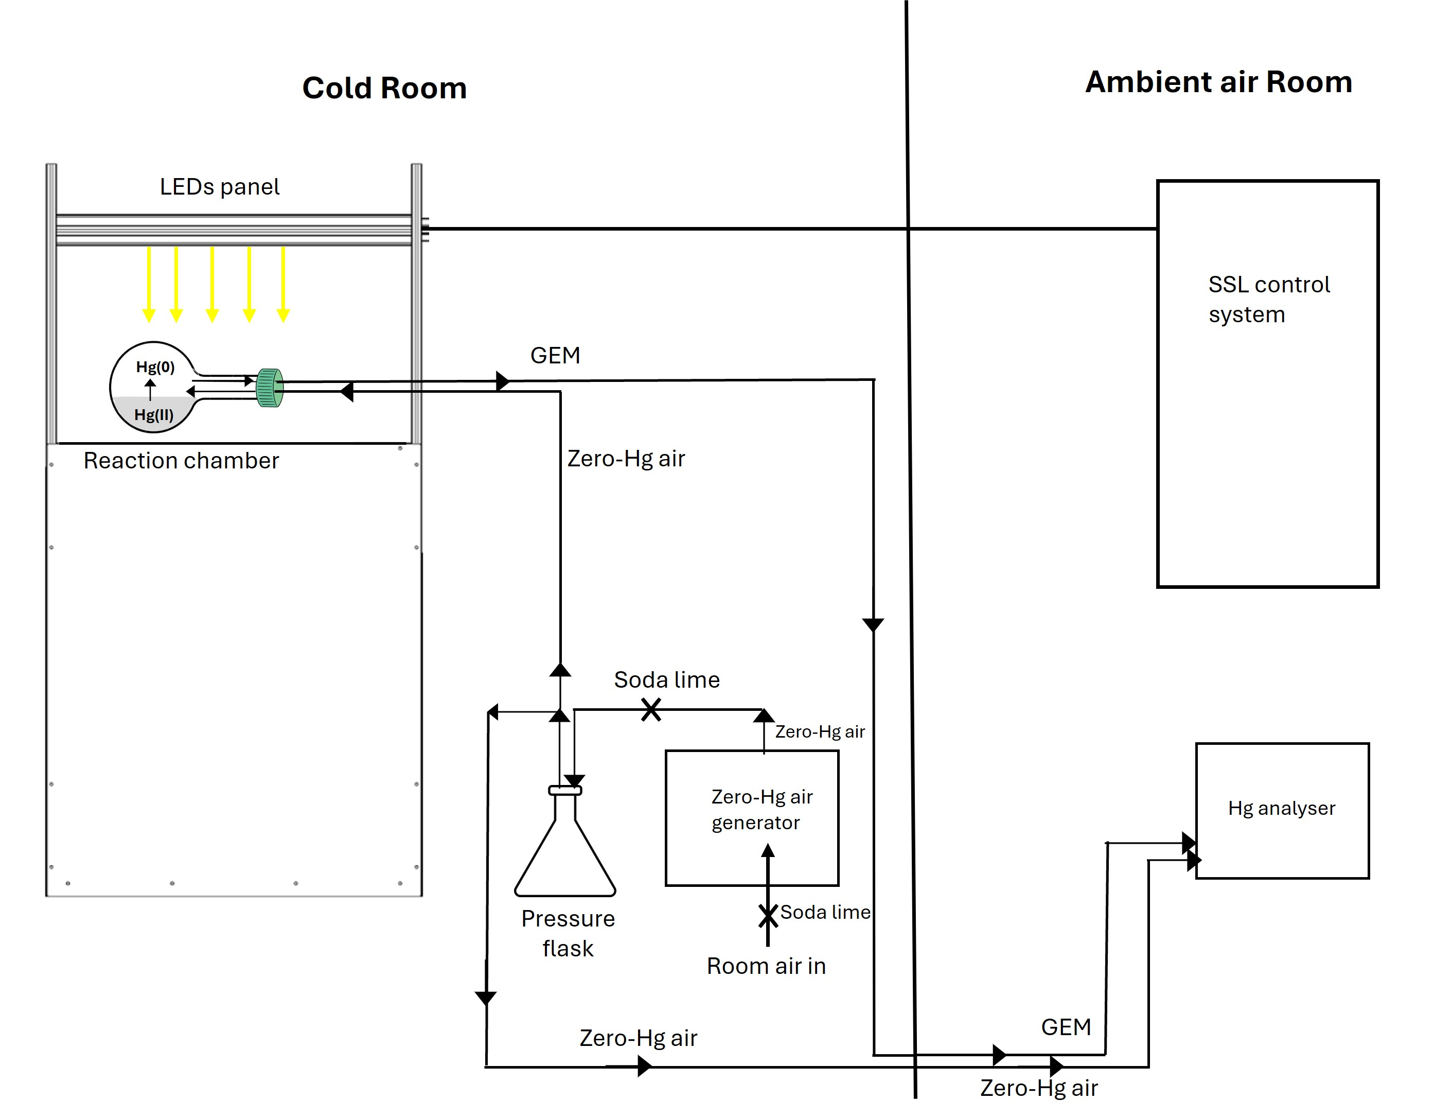
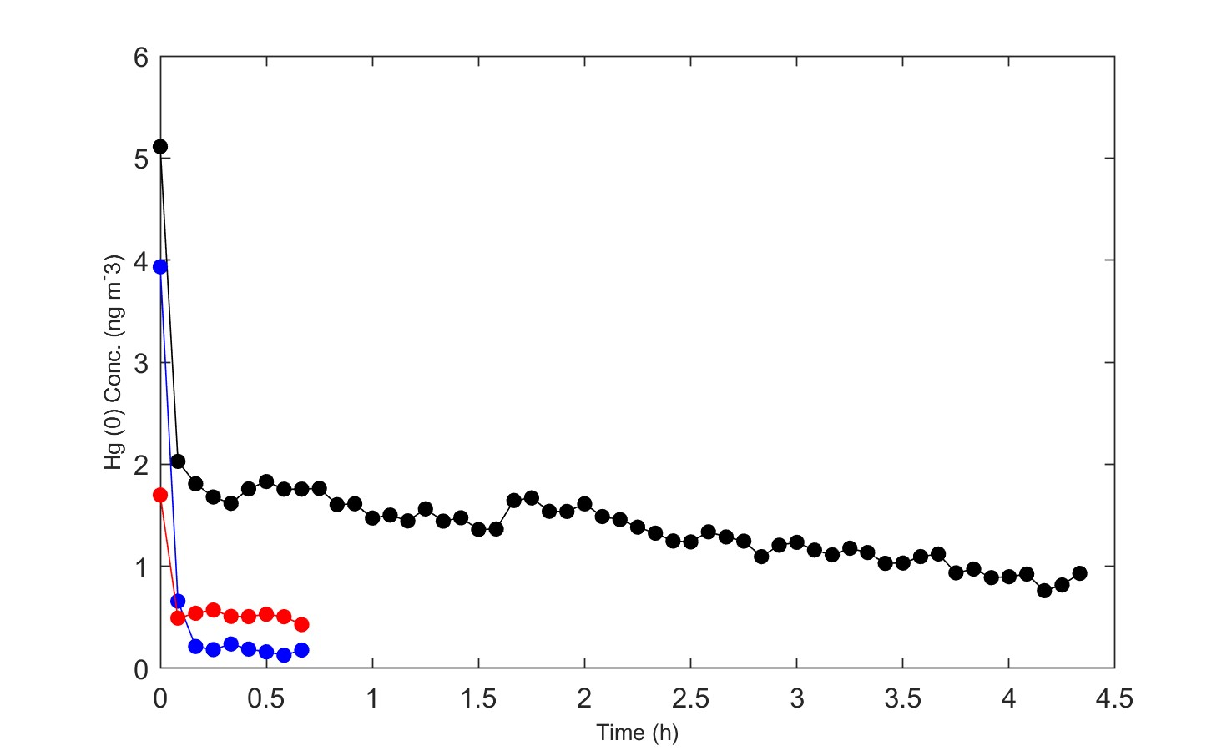
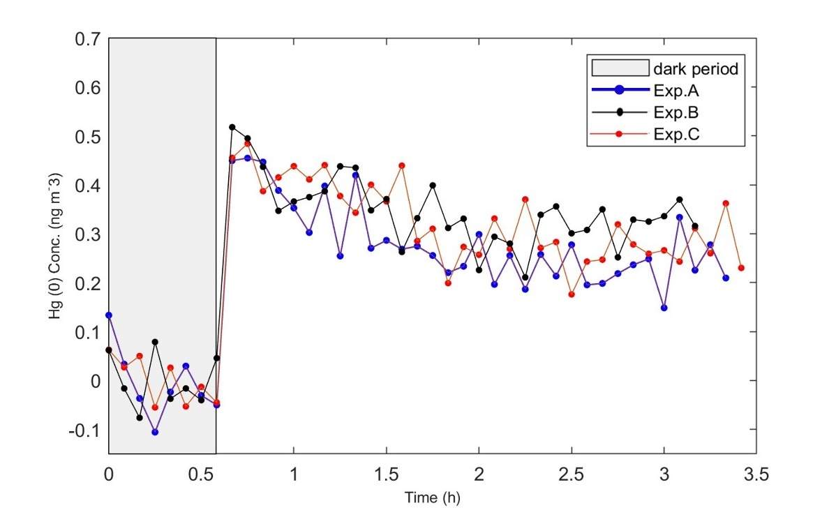
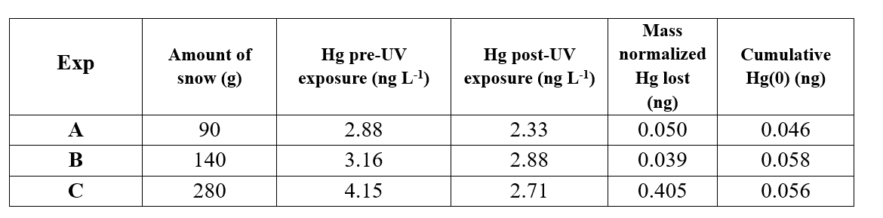
Developing a method for measuring mercury photoreduction in snow with a LED Solar Simulator
G. Celli¹, Z. Gao², D. Armstrong², A. Spolaor^{1,3}, W.R.L. Cairns^{1,3}, F. Wang²
- 20°C
1% Citranox
1% Citranox
10% HCl
Lowest residual Hg(0) in the empty reactor.
1% Citranox
10% HCl
Oven 550°C.
Hg(0)
Dark
UV light
Tekran 2537b
Hg(0)

