Slide 1
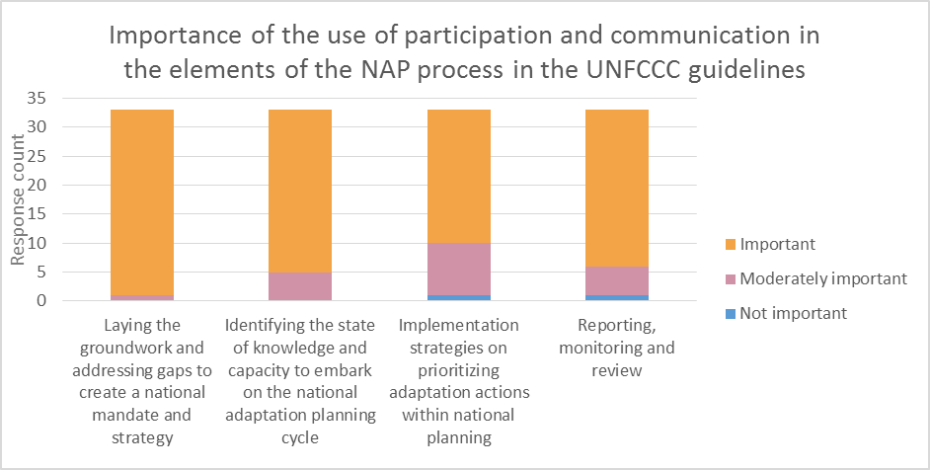
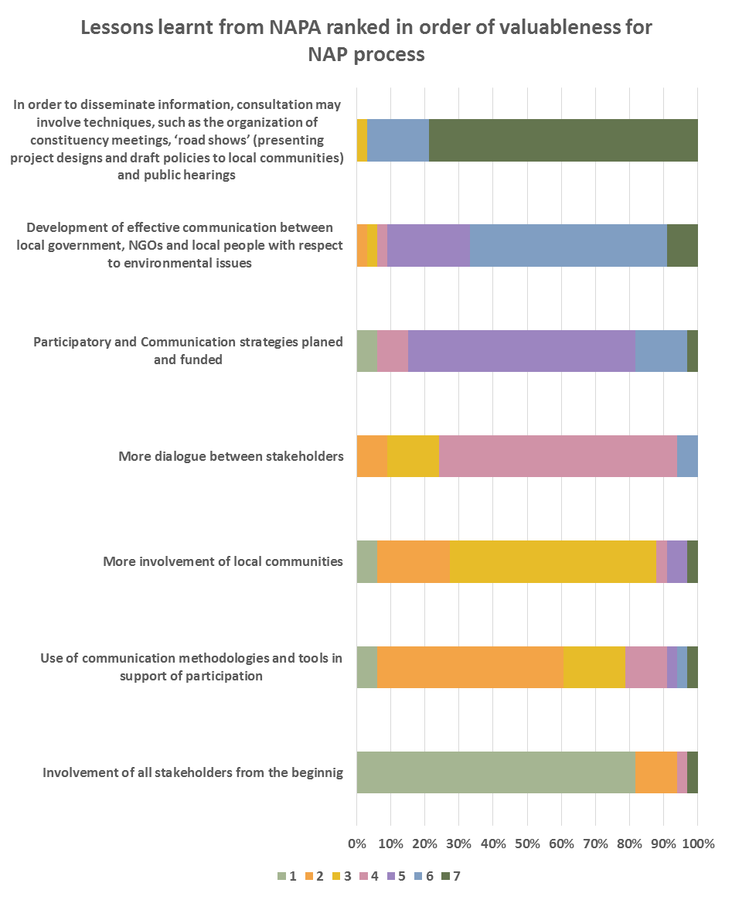
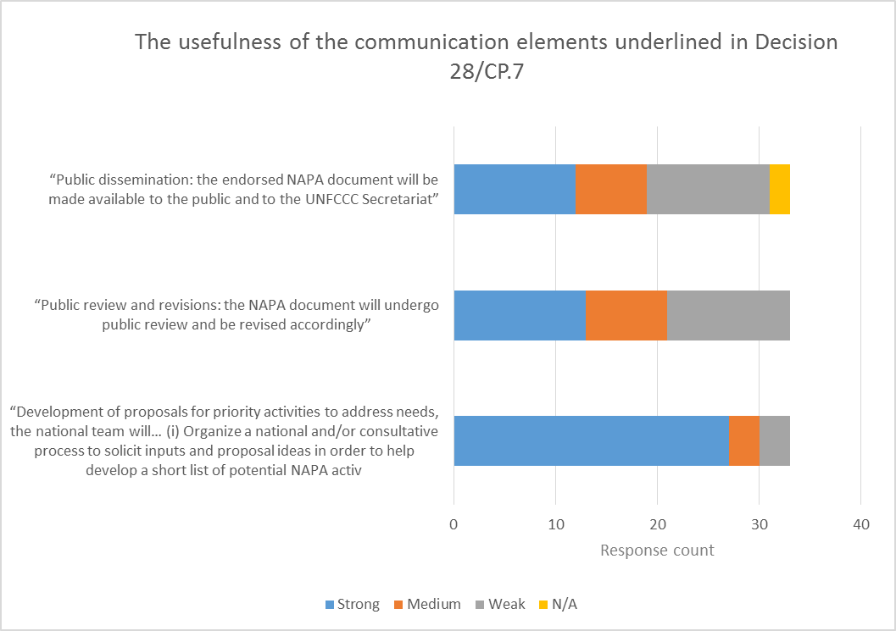
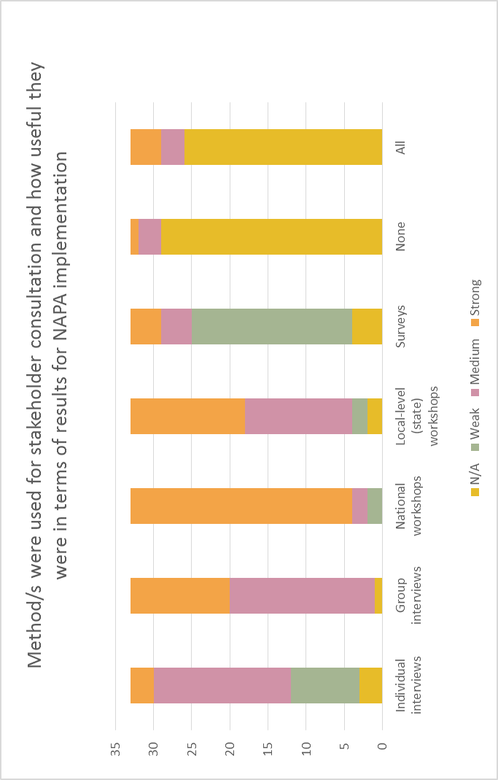
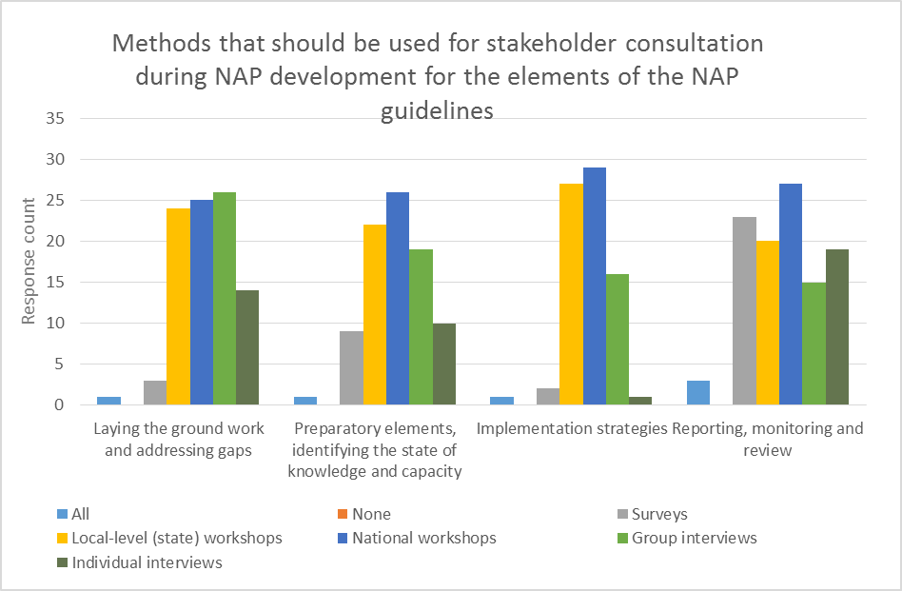
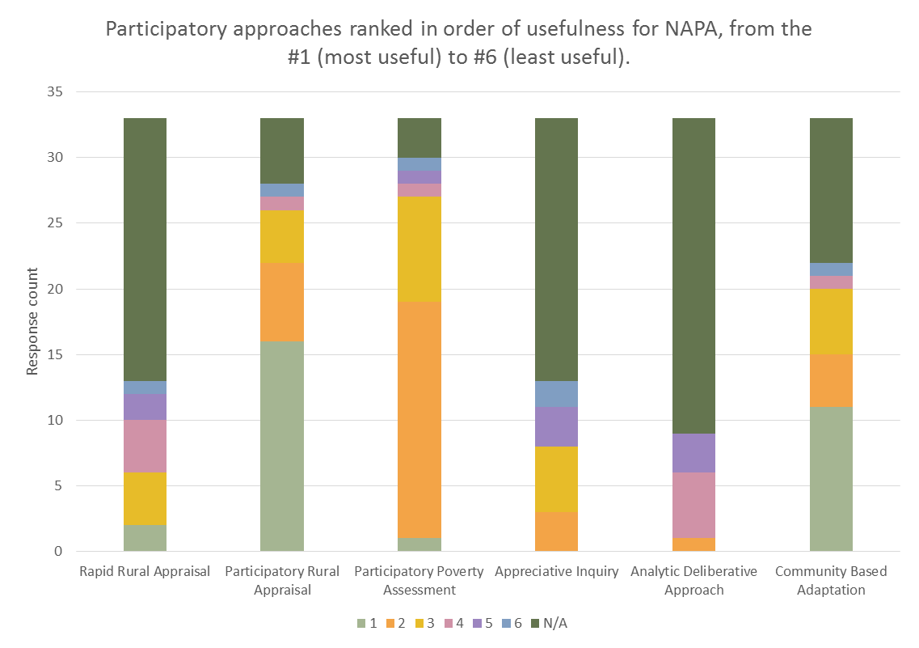
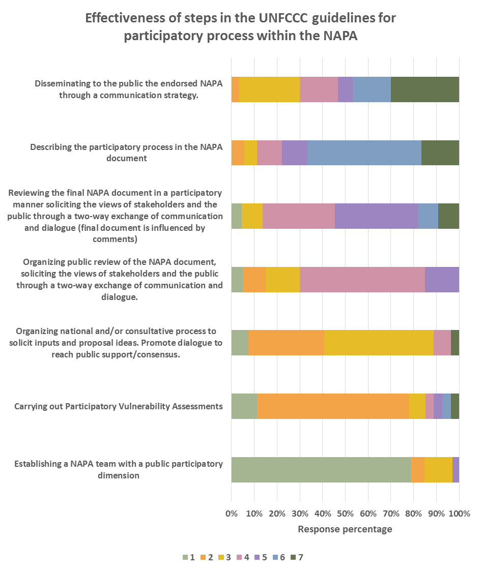
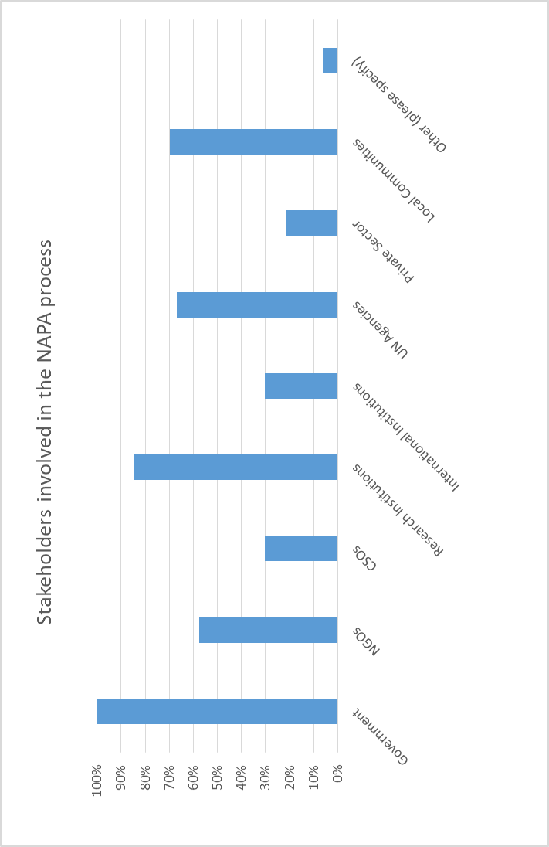
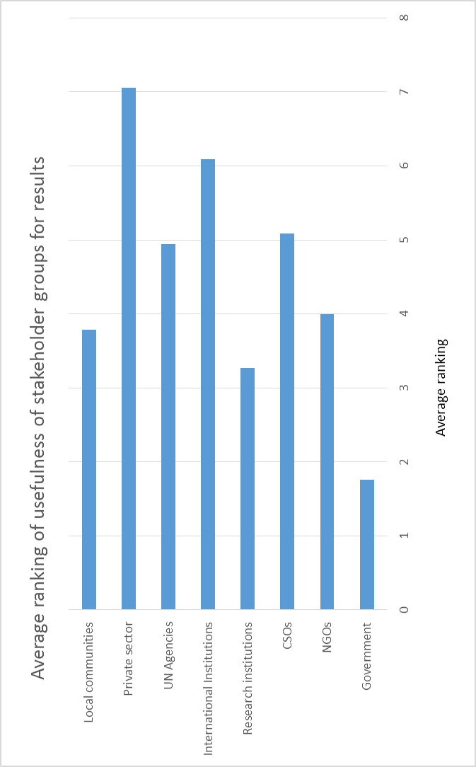
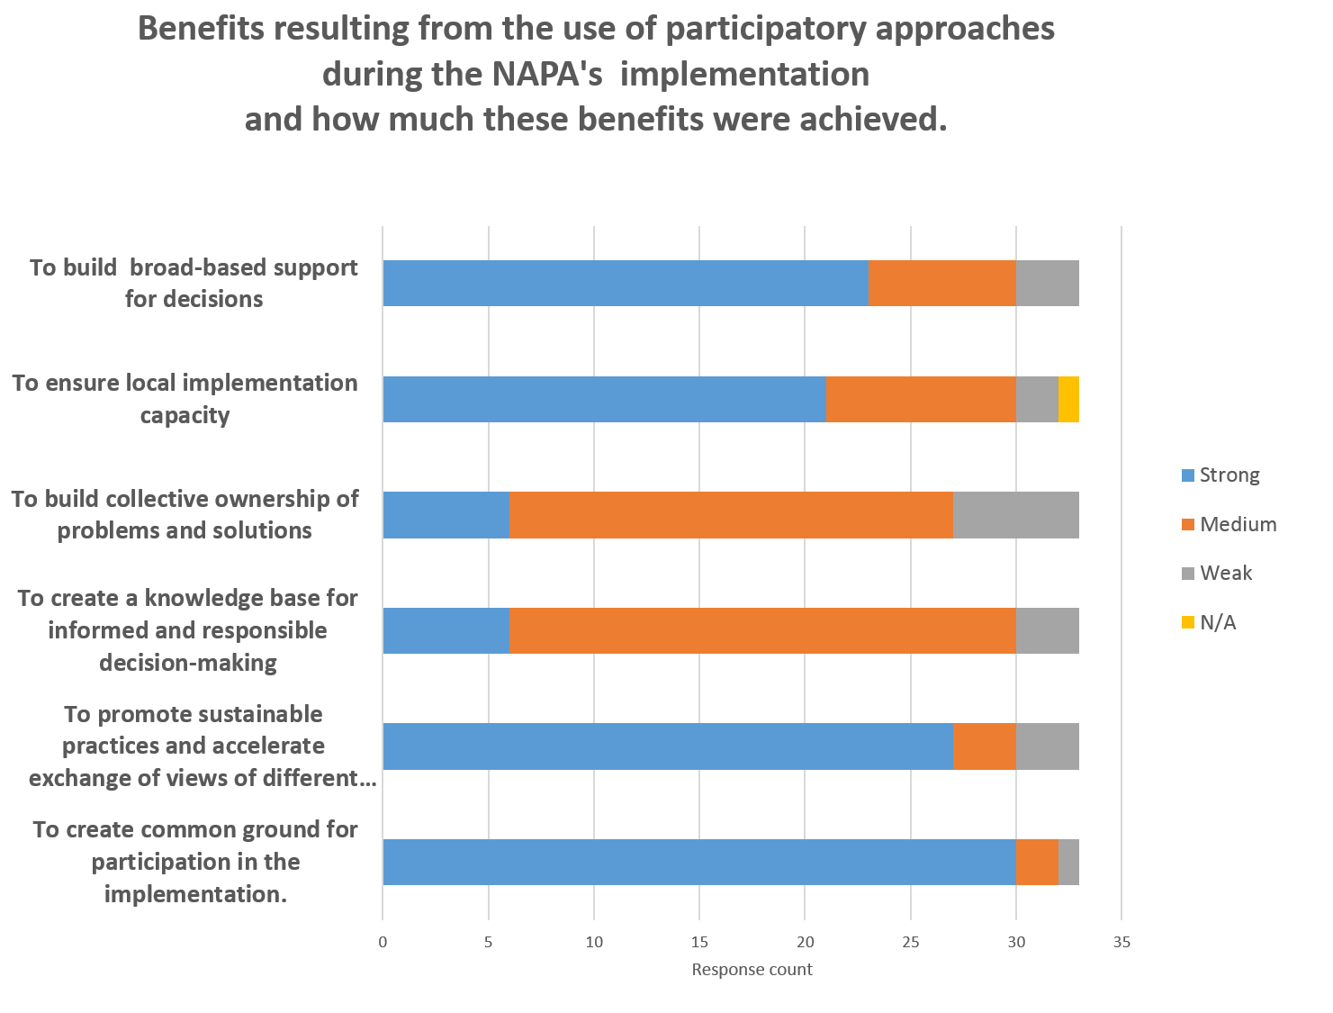
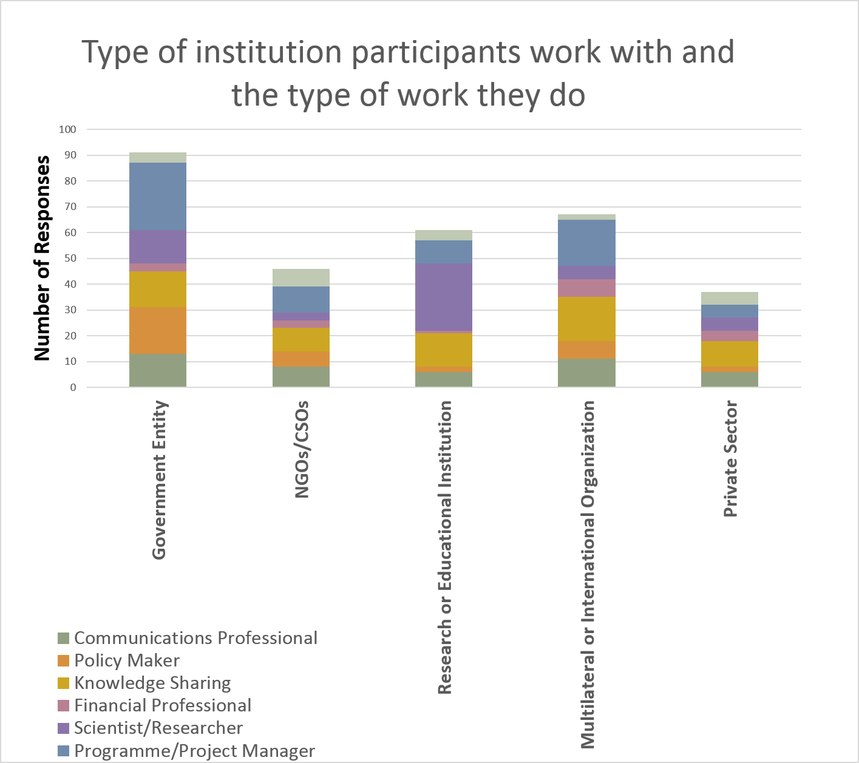
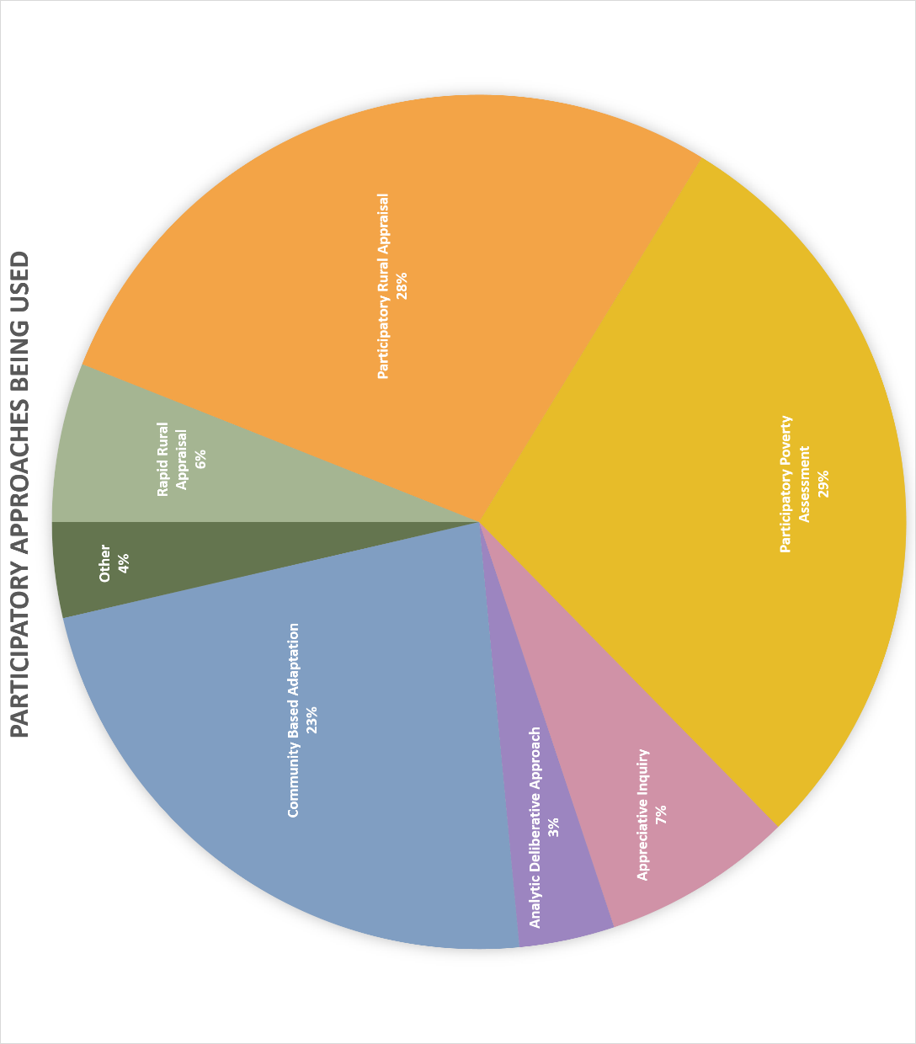
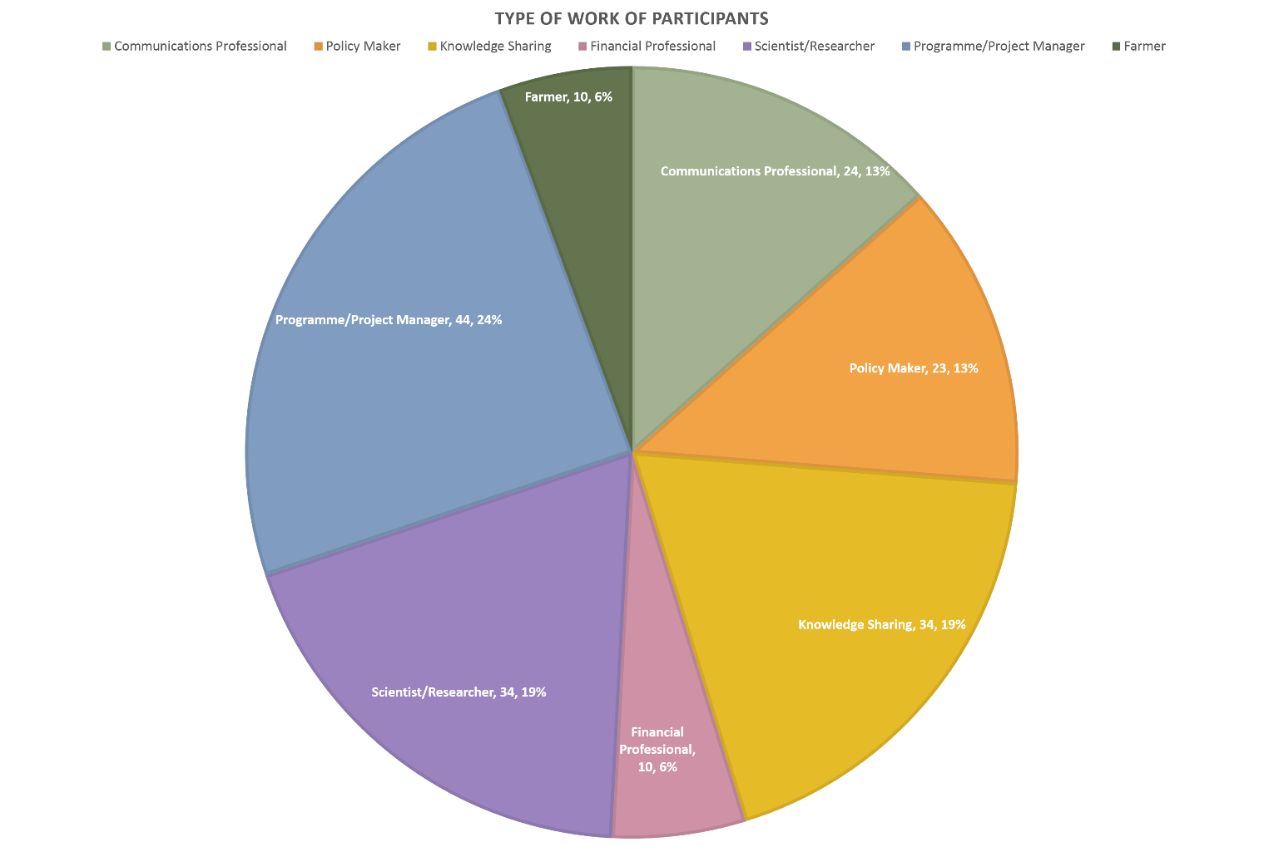
Participatory Approaches
Participatory approaches were, in general, identified to have been used in all steps of the NAPA process.
The most frequently used approaches and more useful were participatory poverty assessment, participatory rural appraisal and community based adaptation.
The results suggest that these participatory approaches should be brought forward for use in the NAP because there will be the greatest capacity in countries to carry out the same approaches again for NAP.
Stakeholders
The most represented stakeholders within the NAPA process were governments, followed by research institutions, UN Agencies and local communities. Private sector and CSOs were underrepresented stakeholders. NGOs were found to be more involved in the NAPA processes in the African region than in Asia.
This suggests that governments are the most important stakeholders to incorporate in the NAP process, in terms of the results. Research institutions are also important stakeholders to be involved. Local communities may also be useful for results in the process.
National workshops, local-level workshops and group interviews were seen as the most effective methods. This indicates the methods that may also work for the NAP process: national workshops, local-level workshops and group interviews. This corresponds with the answers provided in the ‘NAP process’ section (see below).
Communication
The most useful communication element underlined in Decision 28/CP7, as identified by survey participants, is “Development of proposals for priority activities to address needs arising from the adverse effects of climate change: the national team will: (i) Organize a national and/or subnational consultative process to solicit inputs and proposal ideas in order to help develop a short list of potential NAPA activities. The national team would facilitate this consultative process, and would help in translating ideas into activities. This process will allow adequate dialogue between the national team and the public, with time allowed for public comment and revisions.” This communication element involves the greatest amount of public engagement and participation. It suggests that for the NAP process a similar inclusive communication strategy would be useful for the results of the process.
Lessons learnt from NAPA Process
The most important lesson learnt from NAPA, as identified by the participants, is the ‘involvement of all stakeholders from the beginning’. ‘Use of communication methodologies and tools in support of participation’ and ‘more involvement of local communities’ were also seen as important lessons learnt from NAPA.
NAP PROCESS
For the NAP process, almost all of the participants deemed participation and communication ‘important’ or ‘moderately important’ for all of the elements in the overall guidelines for the Parties in the annex to decision 5/CP.17. National and local-level workshops are seen as methods of stakeholder consultation that should be used throughout the NAP process, although this varies for each element. For ‘laying the groundwork and addressing gaps’, group interviews, national workshops and local-level workshops were suggested to be used, along with surveys. For ‘preparatory elements, identifying the state of knowledge and capacity’, national workshops and local-level workshops were methods identified by most participants. For ‘implementation strategies’, national workshops and local-level workshops were indicated by the greatest number of participants, followed by group interviews. For ‘reporting, monitoring and review’, national workshops, followed by surveys and local-level workshops, are the most indicated methods of stakeholder consultation.
CONCLUSIONS AND RECOMMENDATIONS
Figure 12 – importance of the use of participation and communication in the elements of the NAP process in the UNFCCC guidelines, as identified by participants who were involved in NAPA process.
Figure 9 – method/s were used for stakeholder consultation and how useful they were in terms of results for NAPA implementation,
as identified by participants who were involved in NAPA process.
LESSONS LEARNT IN NAPAs
NAPs PROCESS
COMMUNICATION IN NAPAs
Figure 10 –usefulness of the communication elements underlined in Decision 28/CP.7, where N/A represents that the communication element was not utilised, as identified by participants who were involved in NAPA.
Role of participatory approaches and communication in the implementation of the NAPAs and NAPs
Figure 11 –ranking of how valuable lessons learned on NAPAs, related to participation and communication, are for consideration in the development of NAPs – #1 (most valuable) to #7 (least valuable) – as identified by participants who were involved NAPA.
PHD Programme of Science and Management of Climate Change at the Ca Foscari University, Venice, Italy.
Federica Matteoli - Federicamatteoli72@gmail.com
Figure 13 – methods that should be used for stakeholder consultation during NAP development for the elements of the NAP guidelines, as identified by participants who were involved in NAPA.
Figure 4 – participatory approaches ranked in order of usefulness for NAPA, from 1 being most useful to 6 being least useful, as responded by participants who participated in NAPA.
Figure 7 – stakeholders involved in the NAPA process.
Figure 8 – stakeholders ranked by participants involved in NAPA process in terms of usefulness for results,
from the #1 (most relevant) to #8 (least relevant).
NAPAs’ STAKEHOLDERS
Figure 6 – ranking of the steps in the UNFCCC guidelines for the participatory process in the NAPA, from 1 being the most effective in terms of progress and 7 being the least effective, as indicated by participants who were involved in NAPA.
The research methodology has been as following: 1) Desk analysis of documents related with NAPAs, NAPs, participatory approaches and communication methodologies. 2) Explore how participatory approaches and communication methodologies have been used in the design and implementation of NAPAs in the projects developed for implementation activities and in the preparation of NAP in Ethiopia. 3) Realization of face to face interviews and a survey to stakeholders identified such as policy makers, international and local institutions, and communities involved in the realization of NAPAs or experts on climate change and participatory approaches and communication. 4) Analysis of data to detect lessons learnt and recommendations to understand how the use of these approaches can be improved and used for the development of NAPs.
Driving Research Question
How participatory approaches and communication methodologies have been used in the design and implementation of National Adaptation Plan of Actions (NAPAs) to detect lessons learnt and to understand how the use of these approaches can be improved and used for the development of National Adaptation Plans (NAPs).
Aim of the research
To develop a participatory and communication strategy at the global level for NAP and a specific strategy to send to Ethiopian Government to support the design and implementation of NAP.
Figure 5 – benefits resulting from the use of participatory approaches during the NAPA's implementation and how much these benefits were achieved.
INTRODUCTION
METHODOLOGY
RESULTS OF SURVEY
PROFILE OF PARTICIPANTS
Figure 1 – type of institution in which participants work.
PARTICIPATORY APPROACHES
USED IN NAPAs
Figure 3 – which participatory approaches were used in the development of the NAPA, as identified by participants who were involved in the design and implementation of the NAPA. The three people (9%) who responded ‘other’, specified: workshop; Institutional approach; and discussions with national and local governments and local beneficiaries during project design.
Figure 2 – type of work participants are engaged in.

